Slide 1
A sub-Riemannian cortical model with
frequency-phase and its applications
Emre Baspinar
(MathNeuro Team, INRIA Sophia Antipolis)
Joint work with
Giovanna Citti (University of Bologna)
Alessandro Sarti (EHESS)
hart

Slide 2
Outline
Part 0
Part I
Part II

Slide 3
Part 0: General information
Part 0
Part I
Part II

Slide 4
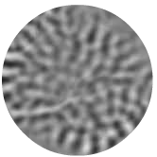
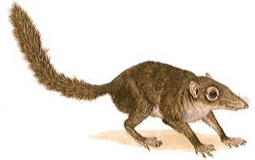
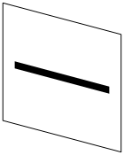
Simple cells
Simple cells are sensitive to:
orientation
frequency
phase…
Notes:
-THANKS TO THE ORIENTATION WE DISTINGUISH

Slide 5
Simple cells
Simple cells are sensitive to:
orientation
frequency
phase…
Notes:
-THANKS TO THE ORIENTATION WE DISTINGUISH

Slide 6
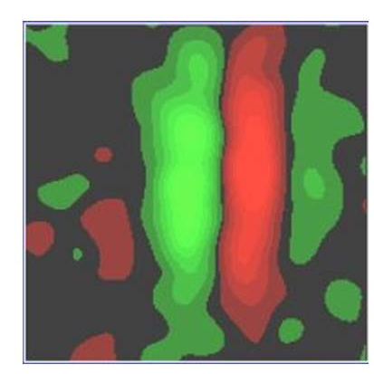
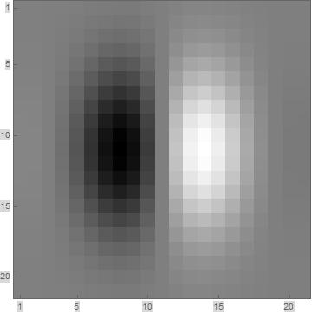
Simple cell receptive profiles: Gabor functions
Experimental receptive profile
Gabor (odd) function
Notes:
-if we restrict ourselves ONLY ORIENTATION SELECTIVE CASE,
-ODD PART OF GABOR MOTHER FCN

Slide 7
Simple cell receptive profiles: Gabor functions
Experimental receptive profile
Gabor (odd) function

Slide 8
Simple cell receptive profiles: Gabor functions
Experimental receptive profile
Gabor (odd) function

Slide 9
Simple cell receptive profiles: Gabor functions
Experimental receptive profile
Gabor (odd) function

Slide 10
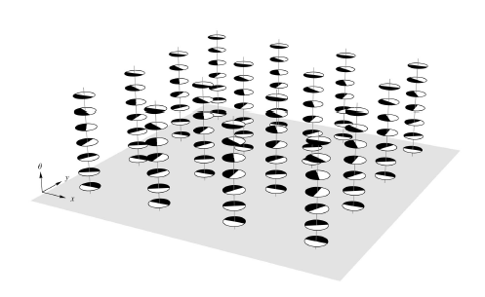






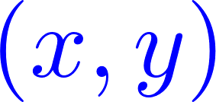
Simple cell receptive profiles: Gabor functions
Experimental receptive profile
Gabor (odd) function
Set of receptive profiles

Slide 11
Cortical models of visual perception
Set of receptive profiles

Slide 12
Cortical models of visual perception
Set of receptive profiles
Notes:
-Why SE(2)?
-It is the natural geometry induced by the Gabor functions-receptive profiles.
-We do not choose a suitable geometry and assign this geometry as a proper framework but WE DERIVE THE GEOMETRY STARTING FROM THE FIRST STEP OF VISUAL PERCEPTION: RECEPTIVE PROFILES.
-

Slide 13
Simple cell receptive profiles: Gabor functions
One form

Slide 14
Simple cell receptive profiles: Gabor functions
One form

Slide 15
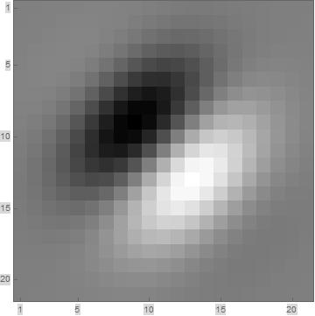
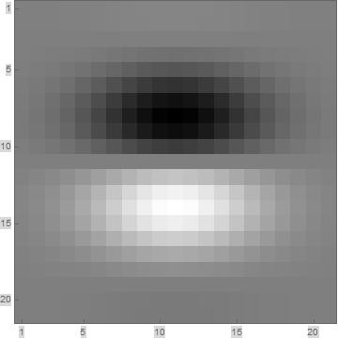
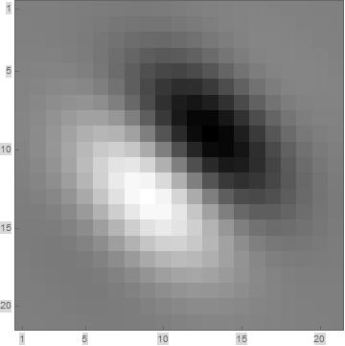
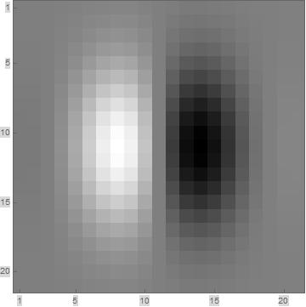
Simple cell receptive profiles: Gabor functions
One form

Slide 16
Simple cell receptive profiles: Gabor functions
One form

Slide 17


Simple cell receptive profiles: Gabor functions
One form

Slide 18

Simple cell receptive profiles: Gabor functions
One form

Slide 19

Simple cell receptive profiles: Gabor functions
One form

Slide 20
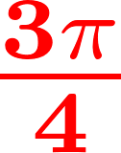
Simple cell receptive profiles: Gabor functions
One form

Slide 21

Simple cell receptive profiles: Gabor functions
One form

Slide 22
Simple cell receptive profiles: Gabor functions
One form

Slide 23
Simple cell receptive profiles: Gabor functions
One form

Slide 24
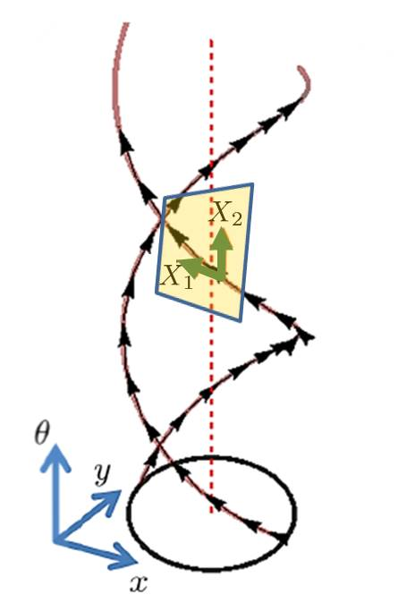
geometry as a cortical model
Horizontal tangent space

Slide 25
geometry as a cortical model
Horizontal tangent space
Sub-Riemannian metric tensor

Slide 26
geometry as a cortical model
Horizontal tangent space
Sub-Riemannian metric tensor
Sub-Riemannian structure

Slide 27
geometry as a cortical model
Horizontal tangent space
Sub-Riemannian metric tensor
Sub-Riemannian structure
Suitable model of the neural connectivity!

Slide 28
Part I: A new cortex model
Part 0
Part I
Part II

Slide 29
Part I: A new cortex model
Part 0
Part I
Part II

Slide 30
Extension to frequency and phase
Notes:
-Following the model of Citti-Sarti, we provide an extension of the model, which is selective to only orientation.
-Now the we extend the model of Citti-Sarti in such a way that we can model not only orientation selectivity but also frequency selectivity of simple cells with their shifted phase behavior.
-Now in addition to the spatial variables x,y, orientation variable \theta, we have the frequency variable \omega and the phase variable \phi. Therefore now we are in a 5-dim space and we will see that it is associtaed to a 5-dim sR-geometry which contains SE(2), the sR-geometry of the Citti-Sarti model at each frequency-phase pair.
-We take the advantage of the versatility of the Gabor functions and introducing the frequency and phase variables in the Gabor functions we find our receptive field model.
-Note that a one form follows directly from the generalized Gabor function.
-This is the main instrument which renders the orientation-frequency selective behavior of simple cells with shifted phases.

Slide 31
Extension to frequency and phase
Notes:
-Following the model of Citti-Sarti, we provide an extension of the model, which is selective to only orientation.
-Now the we extend the model of Citti-Sarti in such a way that we can model not only orientation selectivity but also frequency selectivity of simple cells with their shifted phase behavior.
-Now in addition to the spatial variables x,y, orientation variable \theta, we have the frequency variable \omega and the phase variable \phi. Therefore now we are in a 5-dim space and we will see that it is associtaed to a 5-dim sR-geometry which contains SE(2), the sR-geometry of the Citti-Sarti model at each frequency-phase pair.
-We take the advantage of the versatility of the Gabor functions and introducing the frequency and phase variables in the Gabor functions we find our receptive field model.
-Note that a one form follows directly from the generalized Gabor function.
-This is the main instrument which renders the orientation-frequency selective behavior of simple cells with shifted phases.

Slide 32
Extension to frequency and phase
Notes:
-Following the model of Citti-Sarti, we provide an extension of the model, which is selective to only orientation.
-Now the we extend the model of Citti-Sarti in such a way that we can model not only orientation selectivity but also frequency selectivity of simple cells with their shifted phase behavior.
-Now in addition to the spatial variables x,y, orientation variable \theta, we have the frequency variable \omega and the phase variable \phi. Therefore now we are in a 5-dim space and we will see that it is associtaed to a 5-dim sR-geometry which contains SE(2), the sR-geometry of the Citti-Sarti model at each frequency-phase pair.
-We take the advantage of the versatility of the Gabor functions and introducing the frequency and phase variables in the Gabor functions we find our receptive field model.
-Note that a one form follows directly from the generalized Gabor function.
-This is the main instrument which renders the orientation-frequency selective behavior of simple cells with shifted phases.

Slide 33
Extension to frequency and phase
Notes:
-Following the model of Citti-Sarti, we provide an extension of the model, which is selective to only orientation.
-Now the we extend the model of Citti-Sarti in such a way that we can model not only orientation selectivity but also frequency selectivity of simple cells with their shifted phase behavior.
-Now in addition to the spatial variables x,y, orientation variable \theta, we have the frequency variable \omega and the phase variable \phi. Therefore now we are in a 5-dim space and we will see that it is associtaed to a 5-dim sR-geometry which contains SE(2), the sR-geometry of the Citti-Sarti model at each frequency-phase pair.
-We take the advantage of the versatility of the Gabor functions and introducing the frequency and phase variables in the Gabor functions we find our receptive field model.
-Note that a one form follows directly from the generalized Gabor function.
-This is the main instrument which renders the orientation-frequency selective behavior of simple cells with shifted phases.

Slide 34
Extension to frequency and phase
Notes:
-Following the model of Citti-Sarti, we provide an extension of the model, which is selective to only orientation.
-Now the we extend the model of Citti-Sarti in such a way that we can model not only orientation selectivity but also frequency selectivity of simple cells with their shifted phase behavior.
-Now in addition to the spatial variables x,y, orientation variable \theta, we have the frequency variable \omega and the phase variable \phi. Therefore now we are in a 5-dim space and we will see that it is associtaed to a 5-dim sR-geometry which contains SE(2), the sR-geometry of the Citti-Sarti model at each frequency-phase pair.
-We take the advantage of the versatility of the Gabor functions and introducing the frequency and phase variables in the Gabor functions we find our receptive field model.
-Note that a one form follows directly from the generalized Gabor function.
-This is the main instrument which renders the orientation-frequency selective behavior of simple cells with shifted phases.

Slide 35
Extension to frequency and phase
Notes:
-Following the model of Citti-Sarti, we provide an extension of the model, which is selective to only orientation.
-Now the we extend the model of Citti-Sarti in such a way that we can model not only orientation selectivity but also frequency selectivity of simple cells with their shifted phase behavior.
-Now in addition to the spatial variables x,y, orientation variable \theta, we have the frequency variable \omega and the phase variable \phi. Therefore now we are in a 5-dim space and we will see that it is associtaed to a 5-dim sR-geometry which contains SE(2), the sR-geometry of the Citti-Sarti model at each frequency-phase pair.
-We take the advantage of the versatility of the Gabor functions and introducing the frequency and phase variables in the Gabor functions we find our receptive field model.
-Note that a one form follows directly from the generalized Gabor function.
-This is the main instrument which renders the orientation-frequency selective behavior of simple cells with shifted phases.

Slide 36
Extension to frequency and phase
Simple cell output response
Notes:
-Following the model of Citti-Sarti, we provide an extension of the model, which is selective to only orientation.
-Now the we extend the model of Citti-Sarti in such a way that we can model not only orientation selectivity but also frequency selectivity of simple cells with their shifted phase behavior.
-Now in addition to the spatial variables x,y, orientation variable \theta, we have the frequency variable \omega and the phase variable \phi. Therefore now we are in a 5-dim space and we will see that it is associtaed to a 5-dim sR-geometry which contains SE(2), the sR-geometry of the Citti-Sarti model at each frequency-phase pair.
-We take the advantage of the versatility of the Gabor functions and introducing the frequency and phase variables in the Gabor functions we find our receptive field model.
-Note that a one form follows directly from the generalized Gabor function.
-This is the main instrument which renders the orientation-frequency selective behavior of simple cells with shifted phases.

Slide 37
Extension to frequency and phase
Simple cell output response
Notes:
-Following the model of Citti-Sarti, we provide an extension of the model, which is selective to only orientation.
-Now the we extend the model of Citti-Sarti in such a way that we can model not only orientation selectivity but also frequency selectivity of simple cells with their shifted phase behavior.
-Now in addition to the spatial variables x,y, orientation variable \theta, we have the frequency variable \omega and the phase variable \phi. Therefore now we are in a 5-dim space and we will see that it is associtaed to a 5-dim sR-geometry which contains SE(2), the sR-geometry of the Citti-Sarti model at each frequency-phase pair.
-We take the advantage of the versatility of the Gabor functions and introducing the frequency and phase variables in the Gabor functions we find our receptive field model.
-Note that a one form follows directly from the generalized Gabor function.
-This is the main instrument which renders the orientation-frequency selective behavior of simple cells with shifted phases.

Slide 38
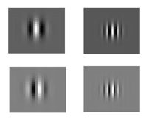
Extension to frequency and phase
One form
Notes:
-Following the model of Citti-Sarti, we provide an extension of the model, which is selective to only orientation.
-Now the we extend the model of Citti-Sarti in such a way that we can model not only orientation selectivity but also frequency selectivity of simple cells with their shifted phase behavior.
-Now in addition to the spatial variables x,y, orientation variable \theta, we have the frequency variable \omega and the phase variable \phi. Therefore now we are in a 5-dim space and we will see that it is associtaed to a 5-dim sR-geometry which contains SE(2), the sR-geometry of the Citti-Sarti model at each frequency-phase pair.
-We take the advantage of the versatility of the Gabor functions and introducing the frequency and phase variables in the Gabor functions we find our receptive field model.
-Note that a one form follows directly from the generalized Gabor function.
-This is the main instrument which renders the orientation-frequency selective behavior of simple cells with shifted phases.

Slide 39
Extension to frequency and phase
Horizontal tangent space
Notes:
-Note that the generators are non-commutative.

Slide 40
Extension to frequency and phase
Horizontal tangent space
Non-commutive Lie algebra
Notes:
-Note that the generators are non-commutative.

Slide 41
Extension to frequency and phase
Horizontal tangent space
Non-commutive Lie algebra
Satisfies the Hörmander condition!
Notes:
-Thanks to non-commutativity Hormander condition is satisfied and the connectivity in the whole space is guaranteed.

Slide 42
The model as a sub-Riemannian structure
Sub-Riemannian manifold
Notes:
-Now we have the manifold M
-The horizontal distribution, the kernel of the one form \lambda
-The horizontal distribution induces the corresponding metric tensor g, where \chi represents the co-vectors of the horizontal vector fields.
-Finally we can recognize our model as the sub-Riemannia structure, given as the following triple here.
-Note that by exploiting the geometry arising from this model we can perform different image processing applications, which employ for example mean curvature flow, or Laplace-Beltrami flow.
-Those two flows are associated to each other.
-At this point I would like to mention about the uniqueness issue of sub-Riemannian mean curvature flow solution.

Slide 43
The model as a sub-Riemannian structure
Sub-Riemannian manifold
Horizontal tangent space
Notes:
-Now we have the manifold M
-The horizontal distribution, the kernel of the one form \lambda
-The horizontal distribution induces the corresponding metric tensor g, where \chi represents the co-vectors of the horizontal vector fields.
-Finally we can recognize our model as the sub-Riemannia structure, given as the following triple here.
-Note that by exploiting the geometry arising from this model we can perform different image processing applications, which employ for example mean curvature flow, or Laplace-Beltrami flow.
-Those two flows are associated to each other.
-At this point I would like to mention about the uniqueness issue of sub-Riemannian mean curvature flow solution.

Slide 44
The model as a sub-Riemannian structure
Sub-Riemannian manifold
Horizontal tangent space
Sub-Riemannian metric tensor
Notes:
-Now we have the manifold M
-The horizontal distribution, the kernel of the one form \lambda
-The horizontal distribution induces the corresponding metric tensor g, where \chi represents the co-vectors of the horizontal vector fields.
-Finally we can recognize our model as the sub-Riemannia structure, given as the following triple here.
-Note that by exploiting the geometry arising from this model we can perform different image processing applications, which employ for example mean curvature flow, or Laplace-Beltrami flow.
-Those two flows are associated to each other.
-At this point I would like to mention about the uniqueness issue of sub-Riemannian mean curvature flow solution.

Slide 45
The model as a sub-Riemannian structure
Sub-Riemannian manifold
Horizontal tangent space
Sub-Riemannian metric tensor
Sub-Riemannian structure
Notes:
-Now we have the manifold M
-The horizontal distribution, the kernel of the one form \lambda
-The horizontal distribution induces the corresponding metric tensor g, where \chi represents the co-vectors of the horizontal vector fields.
-Finally we can recognize our model as the sub-Riemannia structure, given as the following triple here.
-Note that by exploiting the geometry arising from this model we can perform different image processing applications, which employ for example mean curvature flow, or Laplace-Beltrami flow.
-Those two flows are associated to each other.
-At this point I would like to mention about the uniqueness issue of sub-Riemannian mean curvature flow solution.

Slide 46
Part II-a: Image enhancement
Part 0
Part I
Part II

Slide 47
Part II-a: Image enhancement
Part 0
Part I
Part II

Slide 48
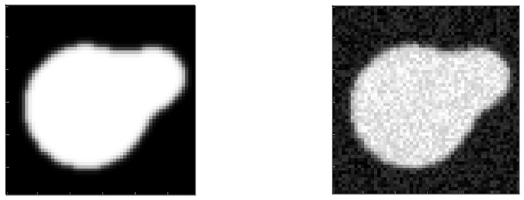
Image enhancement
Noisy image
Original image

Slide 49
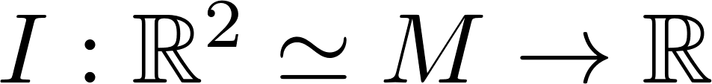
Simple cell outputs
Simple cell output

Slide 50
Simple cell outputs
Simple cell output
Notes:
-The algorithm starts with finding the simple cell output responses for the whole stimulus on the retinal plane.
-It is found via the classical method of filtering the stimulus with rotated Gabor filter banks of each ferquency-phase pair.
-Note that this transform induces the 5-dimensional sub-Riemannian space \mathcal{M}, that is output is defined on the 5-dim space.
-Enhancement is achieved thanks to a Laplace-Beltrami evolution.
-Finally, since we use all frequency components of the Gabor filtering, it is possible to apply inverse Gabor transfrom and the inverse transform projects the enchanced functions defined in the 5-dim
Space to the image functions defined on the 2-dim retinal plane.

Slide 51
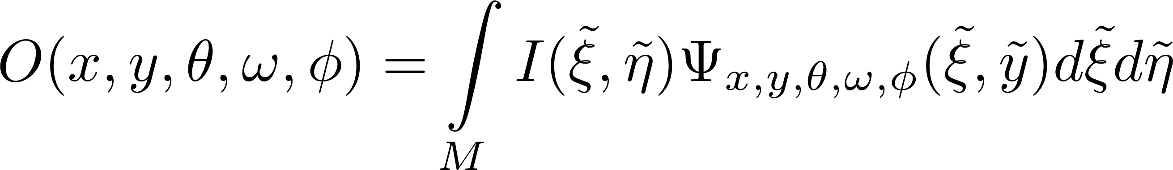
Simple cell outputs
Simple cell output

Slide 52
Laplace-Beltrami evolution
Notes:
-But differently from Kimmel we use MULTI-FREQ. not MULTI-SCALE EVOLUTIONS
-differently from Remco:
*not Heisenberg-Weyl setting but our MODEL FRAMEWORK
*they use different evolution equations, not Laplace-Beltrami as we do

Slide 53
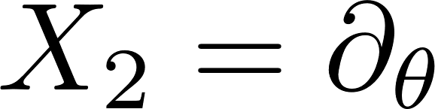
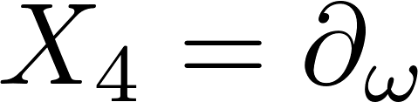
Laplace-Beltrami evolution
Horizontal tangent space

Slide 54
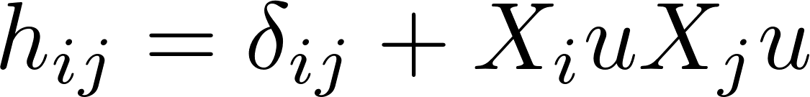
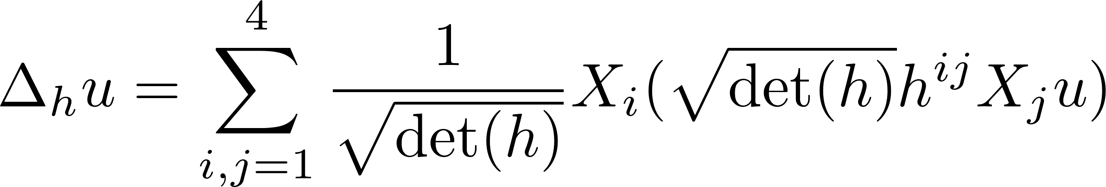
Laplace-Beltrami evolution
Horizontal tangent space
Laplace-Beltrami operator

Slide 55
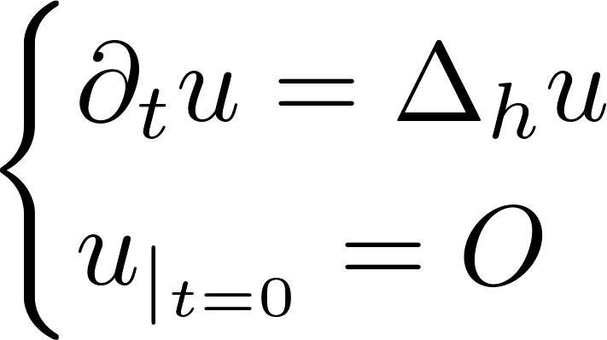
Laplace-Beltrami evolution
Horizontal tangent space
Laplace-Beltrami operator
Evolution equation

Slide 56

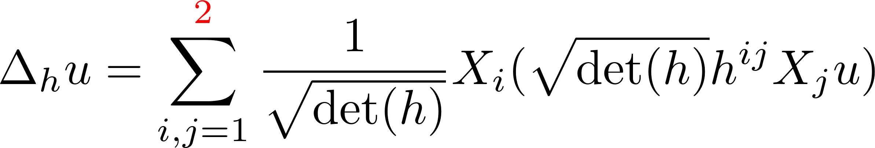
Laplace-Beltrami evolution
Horizontal tangent space
Laplace-Beltrami operator
Evolution equation

Slide 57
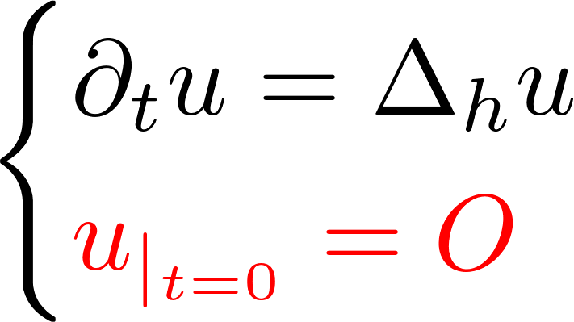
Laplace-Beltrami evolution
Horizontal tangent space
Laplace-Beltrami operator
Evolution equation
Notes:
-we don’t want EXCESSIVE BLURRING-NO DIFFUSION IN IMAGE GRADIENT DIRECTION
-APPROXIMATE THE GEOMETRY AND APPLY THE LAPLACE BELTRAMI IN EACH FREQUENCY CHANNEL!
-PHASE NOT IN THE ENHANCEMENT BUT IN COMPLETION HAS ITS ROLE!

Slide 58
Returning back to the image plane
Inverse Gabor transform

Slide 59
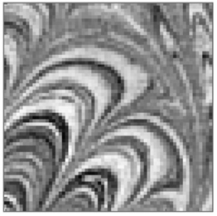
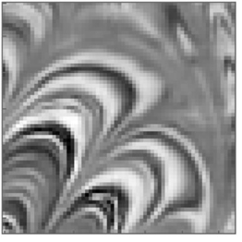
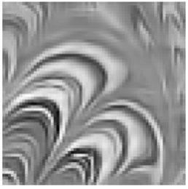
Image enhancement results
Initial image
Multi-freq. Laplace-Beltrami
Multi-scale Laplace-Beltrami
Kimmel et. al., 2000
Notes:
Some example results can be sen here.

Slide 60
Conclusion and new perspectives
Part 0
Part I
Part II

Slide 61
Conclusion and new perspectives
Part 0
Part I
Part II

Slide 62
Conclusion and new perspectives
Part 0
Part I
Part II

Slide 63
Thank you!
63

