Slide 1
Learning the spatiotemporal variability in longitudinal data sets
Application to the modeling and monitoring of Alzheimer’s disease progression
Shape Analysis in Biology
22nd November 2019
Sorbonne Université
Paris, France
Alexandre Bône, Olivier Colliot, Stanley Durrleman

Slide 2
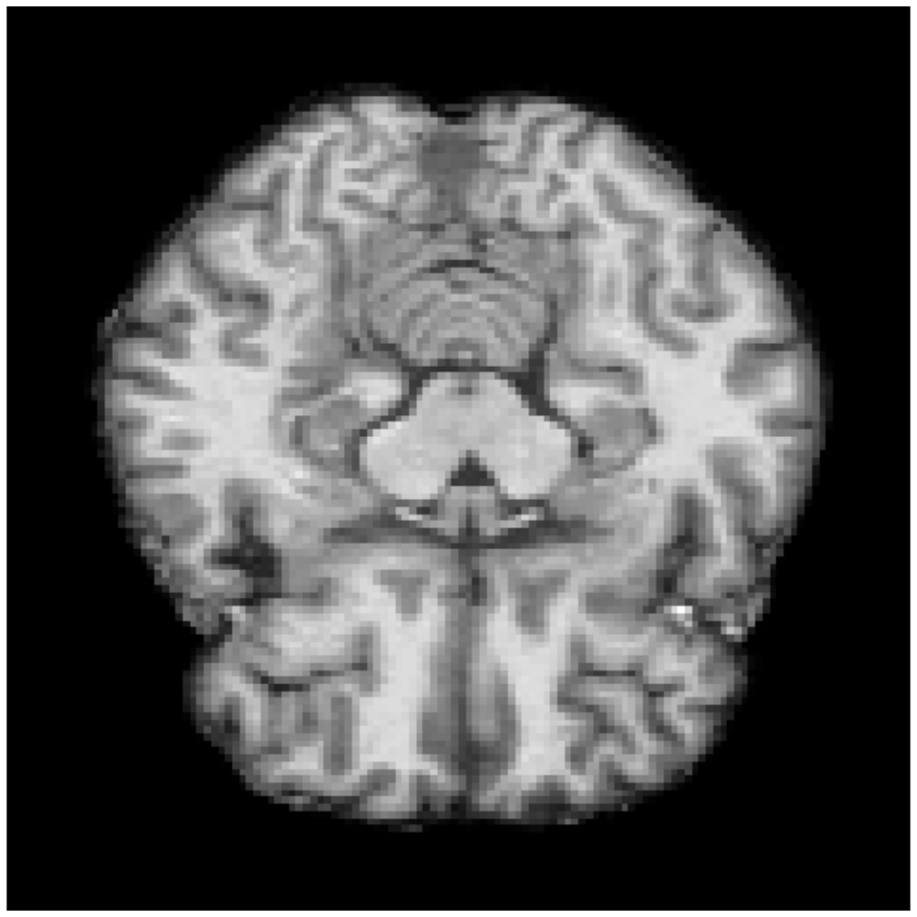
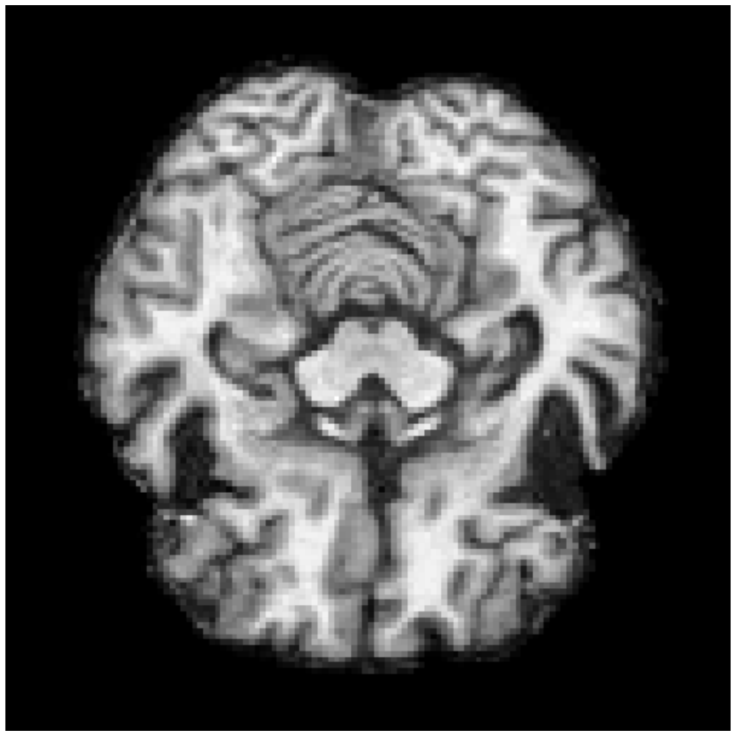
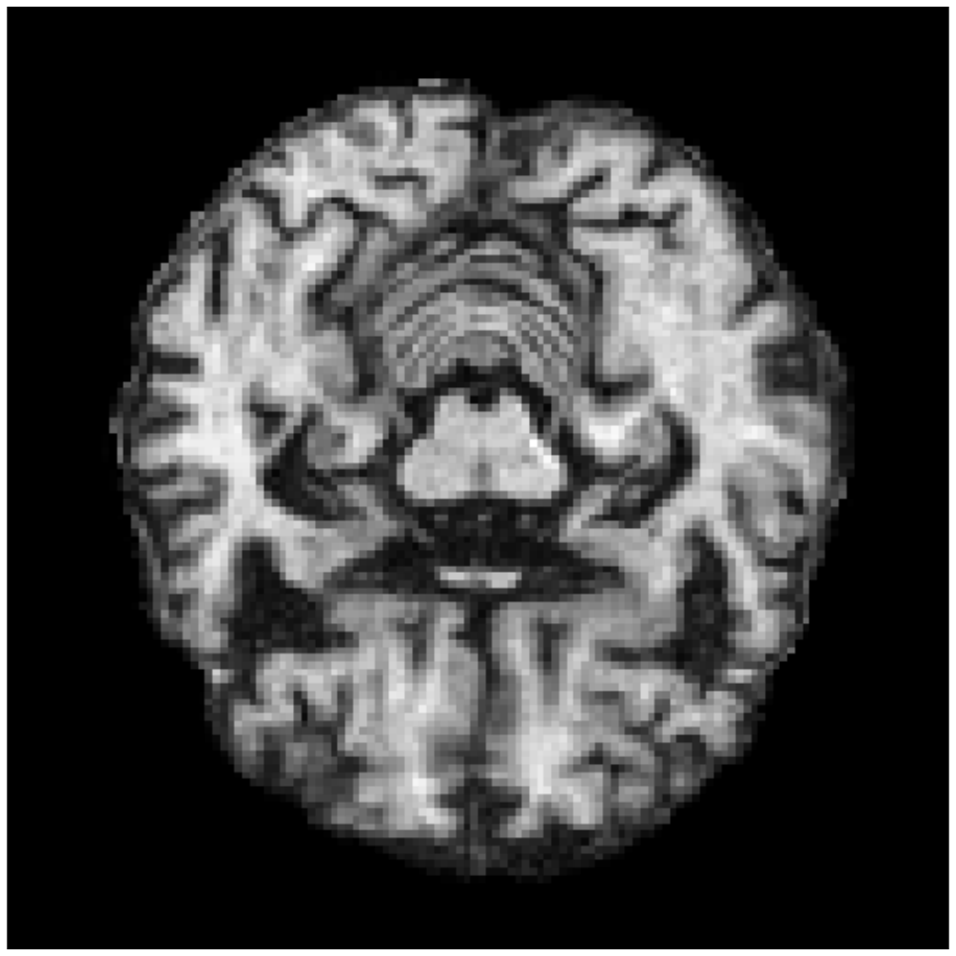
Data: anatomical images of the brain
Focus on Alzheimer’s disease
Either raw images or segmented subcortical structures
Geometry is the signal
CN
MCI
AD
Notes:
Let’s dive now in my own personal work. I mainly develop methods, which means that 90% of my time I am dealing with toy, simulated data sets specifically designed to illustrate or test the limits of the developed methods.
However, the applicative horizon of my work remains the processing of anatomical images of the brain, with a focus on neuro-degenerative diseases and more specifically Alzheimer’s disease.
I spent the remaining 10% of my time to apply my methods on the ADNI data sets, which publicly gathers multimodal data about controls and patients progressing to Alzheimer’s disease.
When dealing with anatomical images of the brain, it is common to rather extract by segmentation mesh representations of sub-cortical structures such as the hippocampus illustrated here. The methods I develop can be applied to either preferred representation, wether meshes or images.
In both cases, it is the geometry of the imaged organs that forms the signal I want to capture

Slide 3
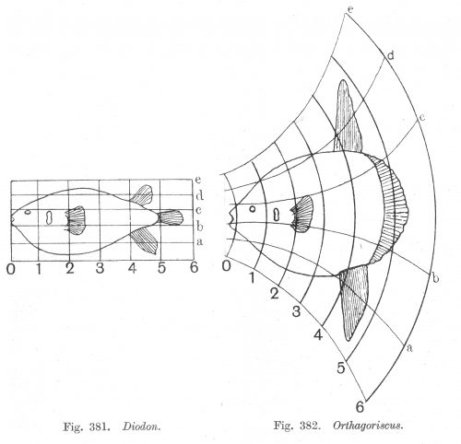

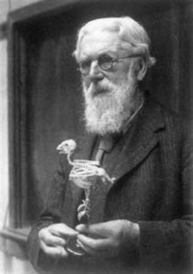

Method: deformation-based shape analysis
Compare the geometrical differences between objects through deformations
“Shape” = geometrical data
$$φ$$
Notes:
To capture this geometrical signal, I heavily rely on shape analysis methods.
Pioneered over a century ago by D’Arcy Thomson, the main idea behind this theoretical framework is to analyse shapes though deformations of the ambient-space that warp them into each other.
To compare the geometrical differences between two objects, for example those two fishes, the contemporary instanciation of this key idea comes down to compute a diffeomorphism of the ambient space that deforms one fish into the other.
With this approach, the analysis of shapes can be advantageously decoupled from the nature of the shapes: if we can analyse fishes, we can also analyse the anatomy of the brain.
In the rest of this talk, the word shape will refer to the geometrical signal contained in mesh or image objects.

Slide 4
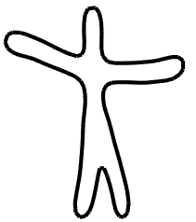
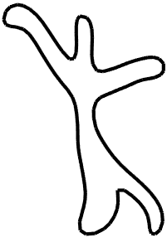
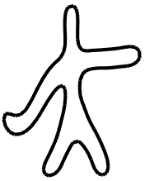
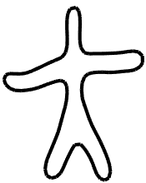
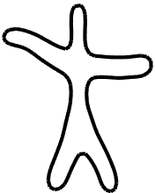
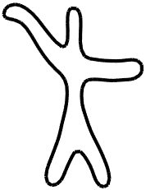
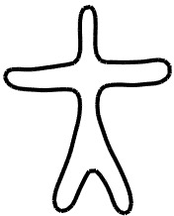

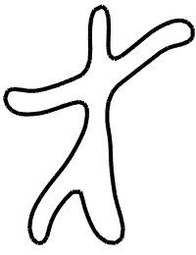
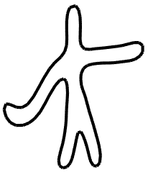
Shape analysis has addressed two main questions
Cross-sectional dataset
of shapes
Time-series dataset
of shapes
y₁
y₂
y₁
y₂
y₃
y₄
ɸ₁
ɸ₂
ɸ₃
ɸ₄
y₀
t → ɸ(t)
y₄
y₃
y₀
”Atlas”
(mean-variance analysis)
“Regression”
Fletcher, Ayache, Pennec, Singh, Durrleman, …
Joshi, Niethammer, Fishbaugh, Gerig, Fletcher, Prastawa, Lorenzi, Ayache, Pennec …

Slide 5
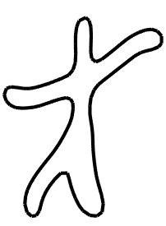
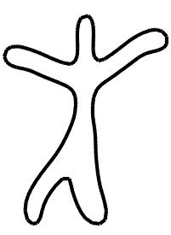
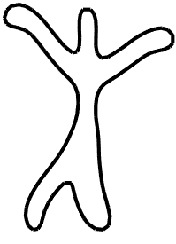
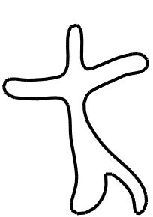
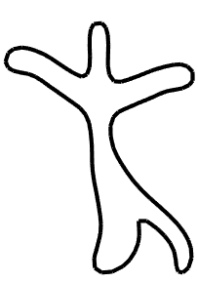
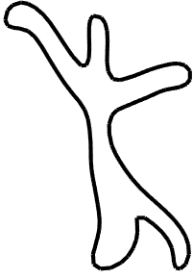
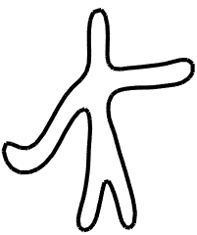
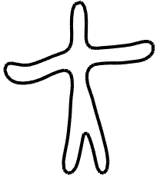
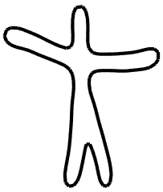
The next question: models for longitudinal data sets
y_{1,1}
y_{1,2}
y_{1,3}
Individuals
y_{2,1}
y_{2,2}
y_{2,3}
Time
y_{3,1}
y_{3,2}
y_{3,3}
Time
Time
Variability in the geometry
Variability in the dynamics

Slide 6
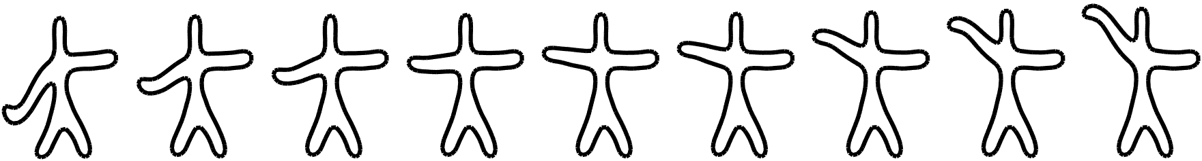
Proposed approach: estimate a distribution of trajectories
y_{1,1}
y_{1,2}
y_{1,3}
y_{2,1}
y_{2,2}
y_{2,3}
Time
ψ₁(Time)
y_{3,1}
y_{3,2}
y_{3,3}
ψ₂(Time)
Time
Time
ψ₃(Time)

Slide 7
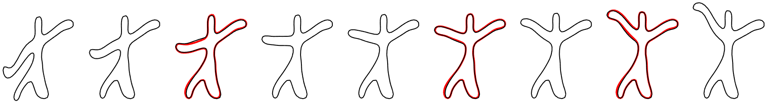
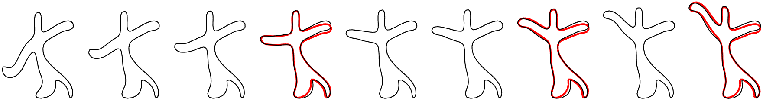
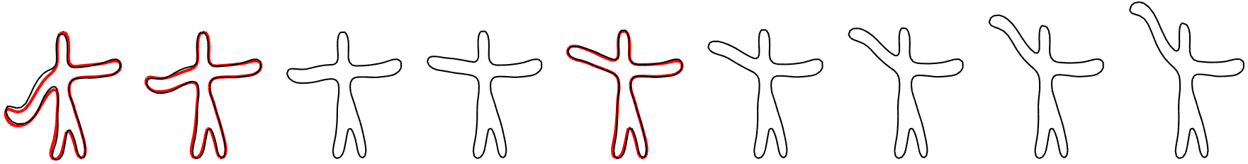
Proposed approach: estimate a distribution of trajectories
Notes:
- Taking now a converse, generative viewpoint: we would like to be able to personalize this abstract population-average progression to fit the original observations, here indicated in red

Slide 8
Learning the spatiotemporal variability in longitudinal data sets
Deformation model 10 mn
  A manifold of diffeomorphisms
  Exp-parallelism on manifolds
Statistical model 5 mn
  Graphical model
  Estimation
Experiments 15 mn
  Simulated man-shapes
  Hippocampal atrophy in ADNI

Slide 9
Learning the spatiotemporal variability in longitudinal data sets
Deformation model 10 mn
  A manifold of diffeomorphisms
  Exp-parallelism on manifolds
Statistical model 5 mn
  Graphical model
  Estimation
Experiments 15 mn
  Simulated man-shapes
  Hippocampal atrophy in ADNI

Slide 10
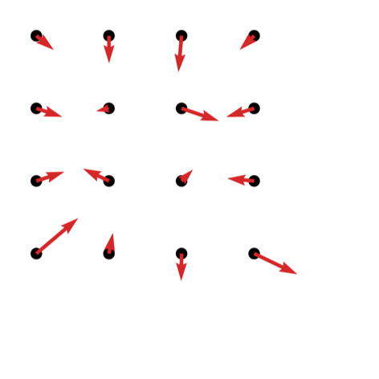
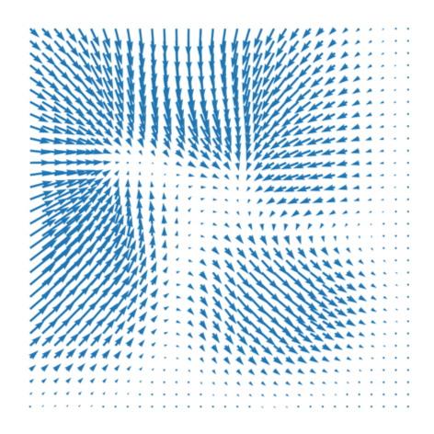




Building diffeomorphisms
$$v_{0}=K_{c_{0}}∙m_{0}$$
Prescribed convolution operation $K_{c_{0}}$
$${(c}_{0}, m_{0})$$
$$v_{0}$$
Notes:
Coming back to the foundations of shape analysis: how can we devise an algorithm to deform shapes ?
Let’s take a finite set of points, called control points, in the ambient 2D or 3D space, and attach to them vectors, called momentum.
We define a kernel-base convolution operator that defines a continuous vector field, called velocity field, computed from those control points and momenta

Slide 11
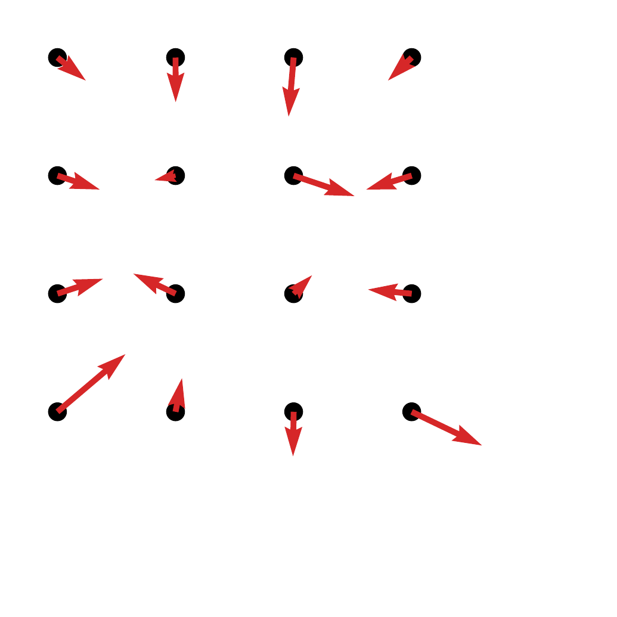
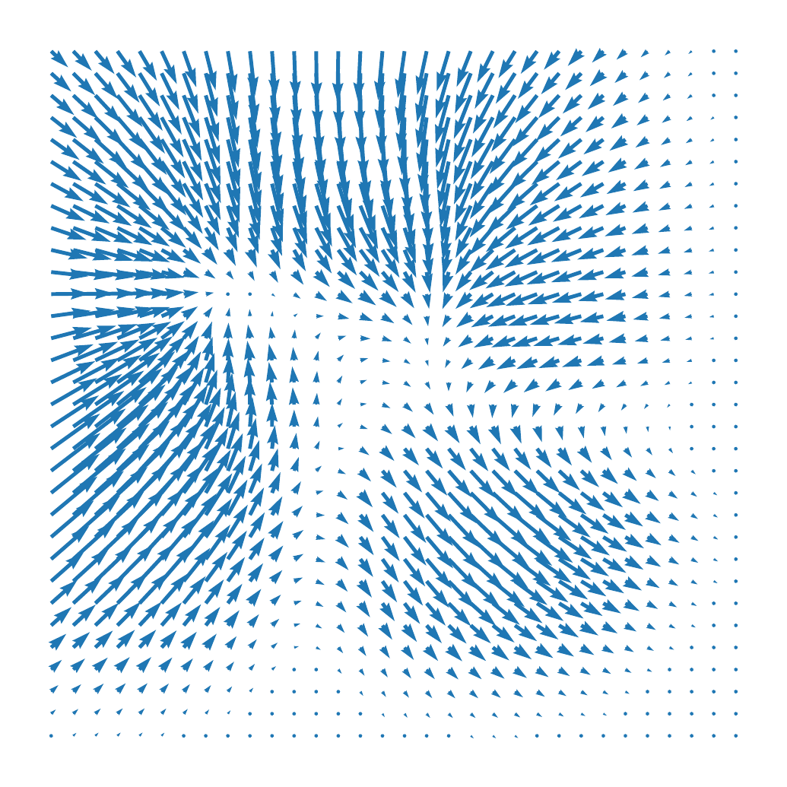




Building diffeomorphisms
$$v_{t}=K_{c_{t}}∙m_{t}$$
Prescribed convolution operation $K_{c_{0}}$
Prescribed “Hamiltonian” dynamics: $\frac{∂c_{t}}{∂t}=K_{c_{t}}∙m_{t}$, $\frac{∂m_{t}}{∂t}=−\frac{1}{2}∇_{c_{t}}(m_{t}^{T}∙K_{c_{t}}∙m_{t})$
$$t→{(c}_{t}, m_{t})$$
$$t→v_{t}$$

Slide 12

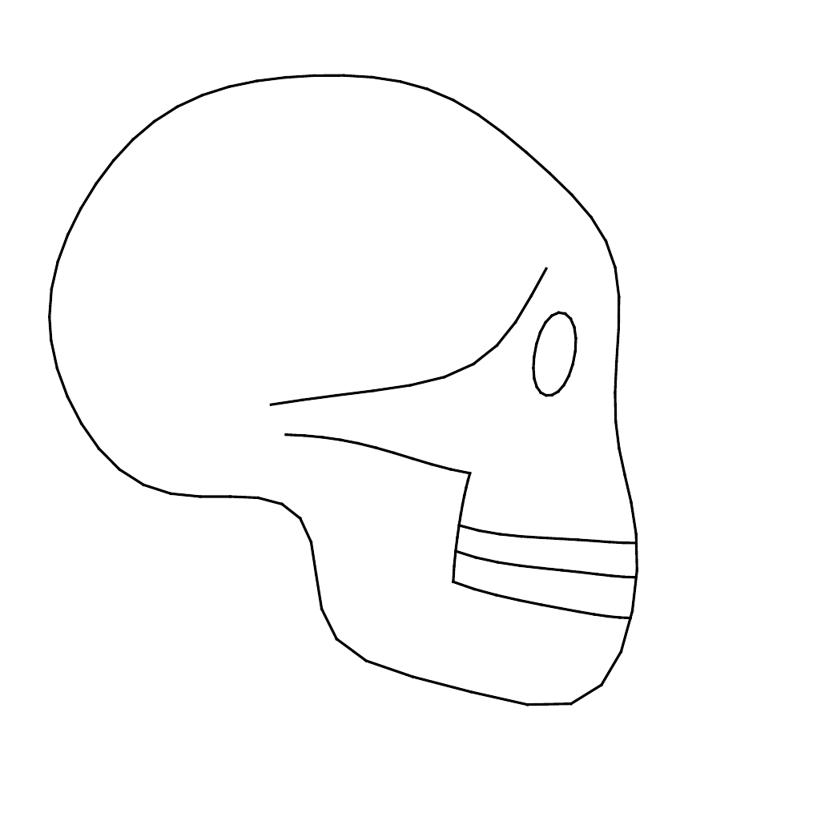

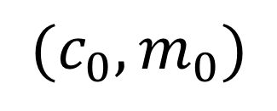


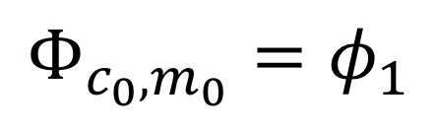
Building diffeomorphisms
$$v_{t}=K_{c_{t}}∙m_{t}$$
$$∂_{t}φ_{t}=v_{t}∘φ_{t}$$
Deform image or mesh
$$t→{(c}_{t}, m_{t})$$
$$t→v_{t}$$
$$t→φ_{t}$$
$$t→φ_{t}⋆y_{0}$$
$${(c}_{0}, m_{0})$$
$${Φ_{c_{0},m_{0}}=φ}_{1}$$
The obtained set of diffeomorphisms $𝒟_{c_{0}}=\{Φ_{c_{0}, m_{0}}|m_{0}\}$ forms a Riemannian manifold
Morphometry of anatomical shape complexes with dense deformations and sparse parameters, Durrleman et al, 2014
Notes:
And the flows of diffeomorphisms here defined form the geodesics of this Riemannian manifold.

Slide 13
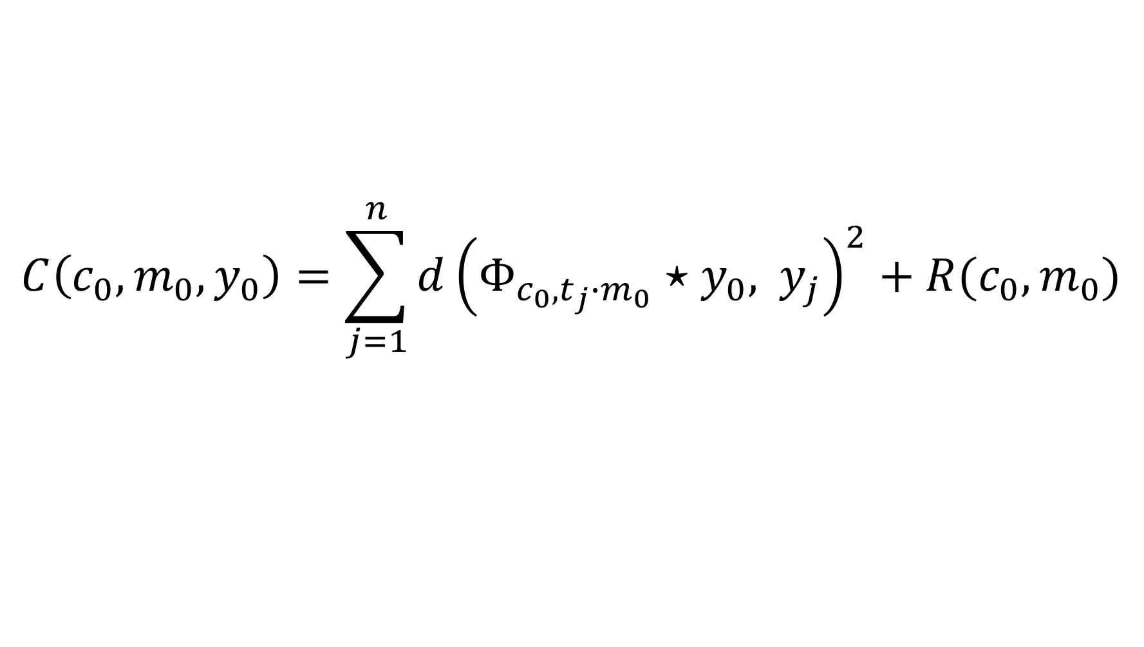
Example: geodesic regression
$$C\left(c_{0}, m_{0}, y_{0}\right)=\sum_{j=1}^{n}{d{\left(Φ_{c_{0},t_{j}∙m_{0}}⋆y_{0}, { y}_{j}\right)}^{2}+R(c_{0}, m_{0})}$$
Initial control points
Initial momenta
Template shape
Regularization cost
Diffeomorphism
Obervations
Estimated by gradient descent
t → ɸ(t)
y₀
Geodesic shape regression with multiple geometries and sparse parameters, Fishbaugh et al, 2016

Slide 14
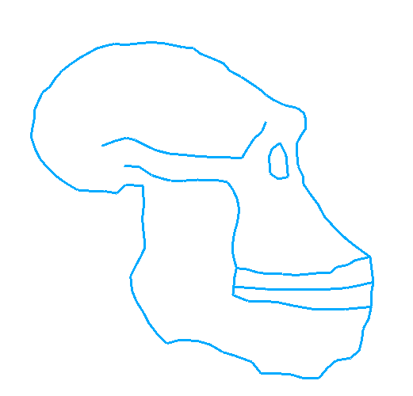
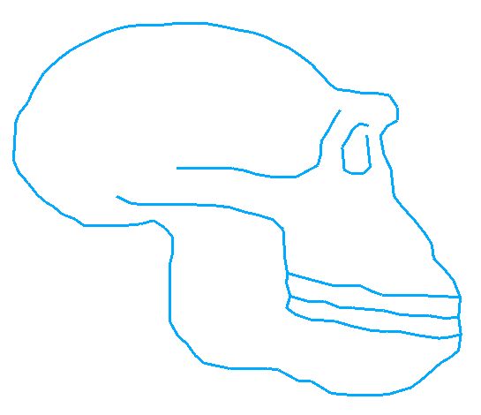
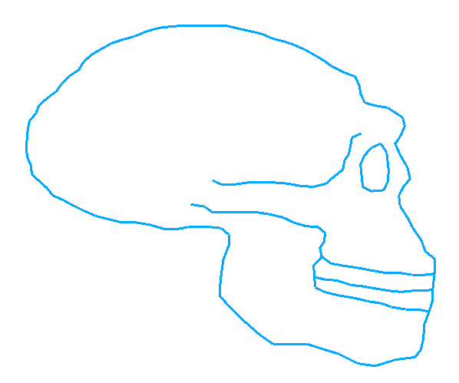
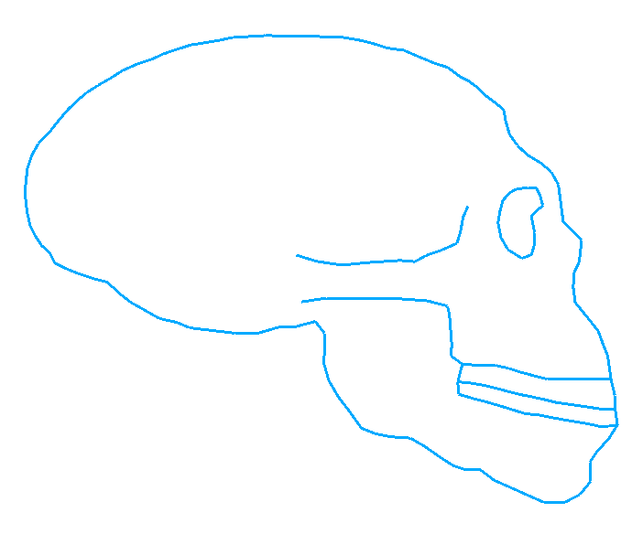
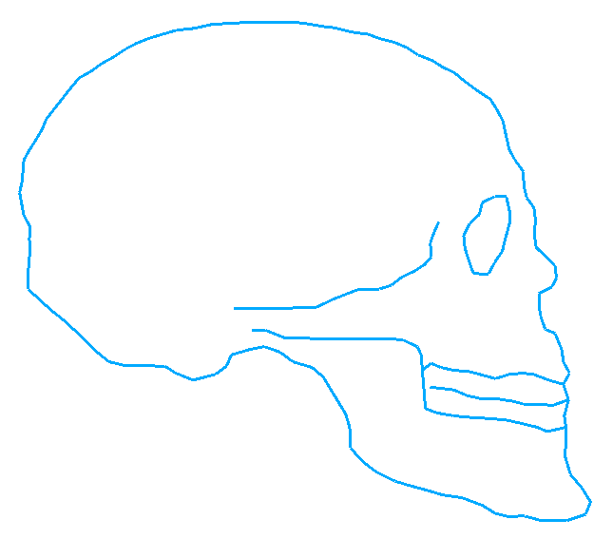
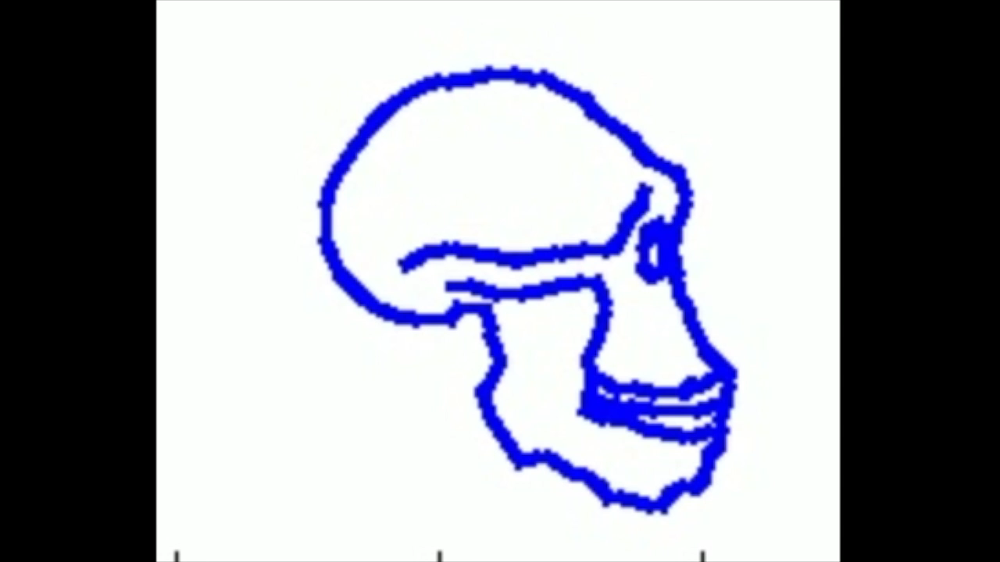
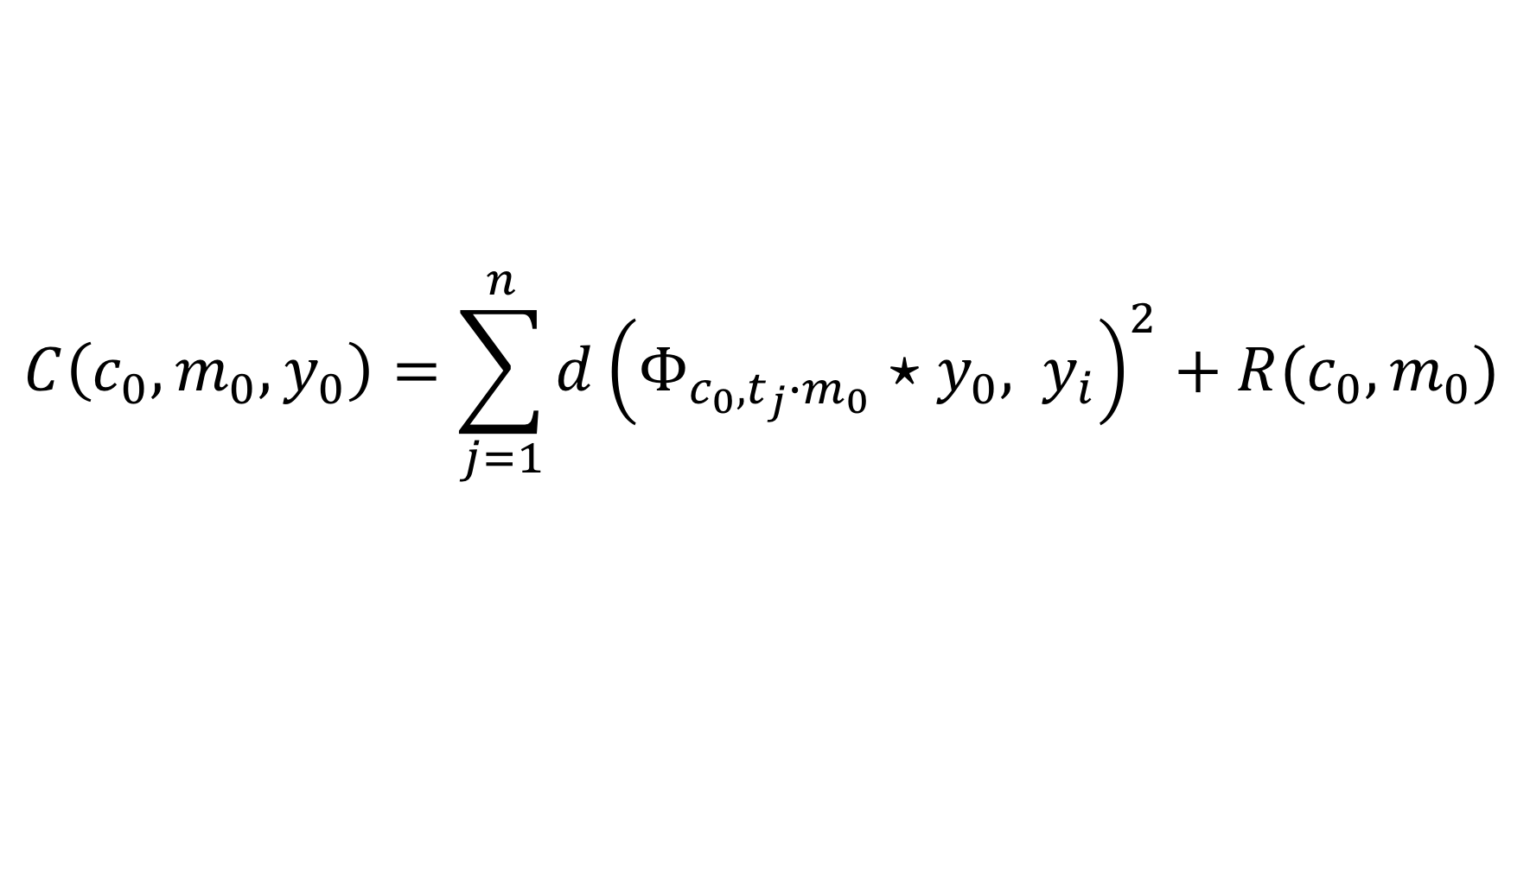
Example: geodesic regression
$$C\left(c_{0}, m_{0}, y_{0}\right)=\sum_{j=1}^{n}{d{\left(Φ_{c_{0},t_{j}∙m_{0}}⋆y_{0}, { y}_{i}\right)}^{2}+R(c_{0}, m_{0})}$$

Slide 15
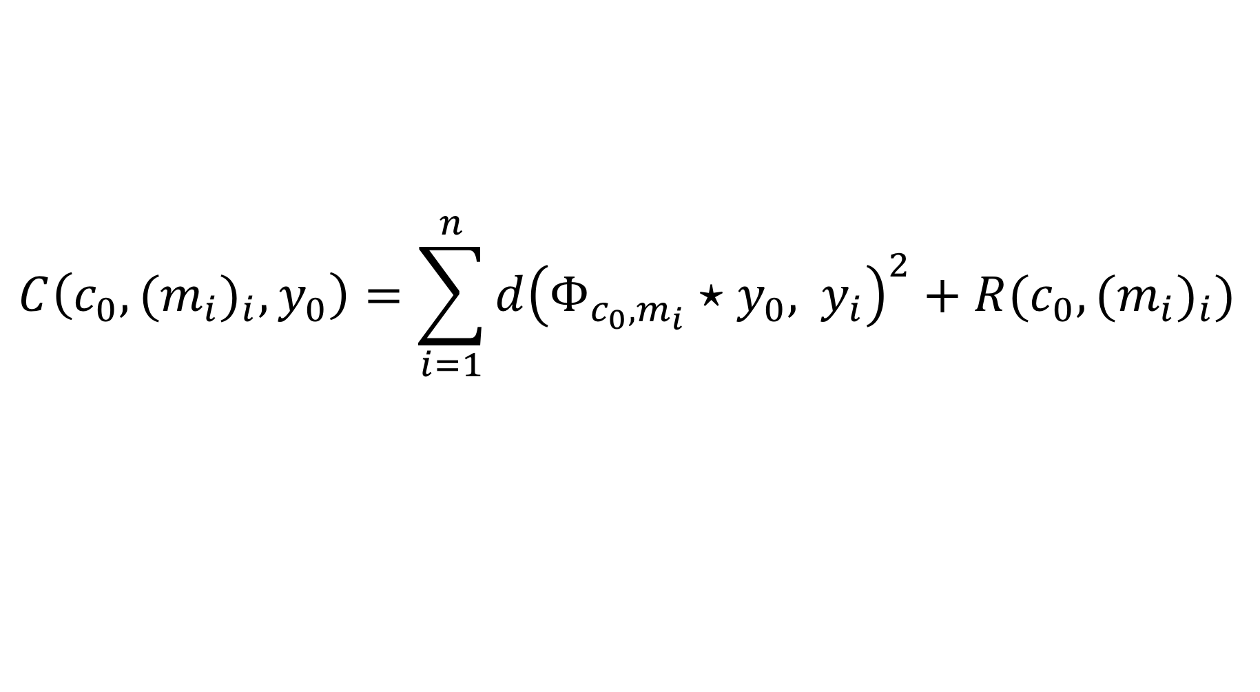
Example: atlas construction
$$C\left(c_{0}, {{(m}_{i})}_{i}, y_{0}\right)=\sum_{i=1}^{n}{d{\left(Φ_{c_{0}, m_{i}}⋆y_{0}, { y}_{i}\right)}^{2}+R(c_{0},{{(m}_{i})}_{i})}$$
One initial momenta for each subject
ɸ₁
ɸ₂
ɸ₃
Estimated by gradient descent
ɸ₄
y₀
Morphometry of anatomical shape complexes with dense deformations and sparse parameters, Durrleman et al, 2014

Slide 16
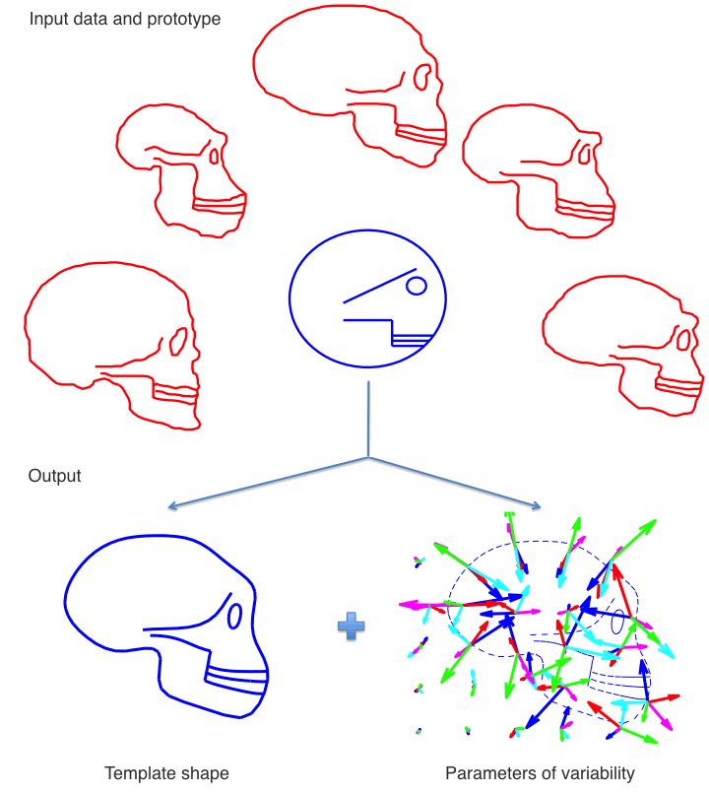
Example: atlas construction

Slide 17
Back to longitudinal data
?

Slide 18
Exp-parallelism on a Riemannian manifold
Transported curve
Space-shift
Source geodesic
Parallel transport of
Learning spatiotemporal trajectories from manifold-valued longitudinal data, Schiratti et al, 2015
Notes:
To perform this longitudinal analysis, we define the notion of parallel shifting on a manifold.
Let gamma be a geodesic on a Riemannian manifold. It is parametrized a tangent vector at some base point. Let w be another tangent vector at this same base point.
We want to shift this blue geodesic along this red tangent vector.
To this end, we use the parallel transport operator to compute the translated space shift along the geodesic. This operator is defined on any Riemannian manifold.
Taking the Riemannian exponential of this transported vector at all points finally defines the transported curve eta on the manifold

Slide 19
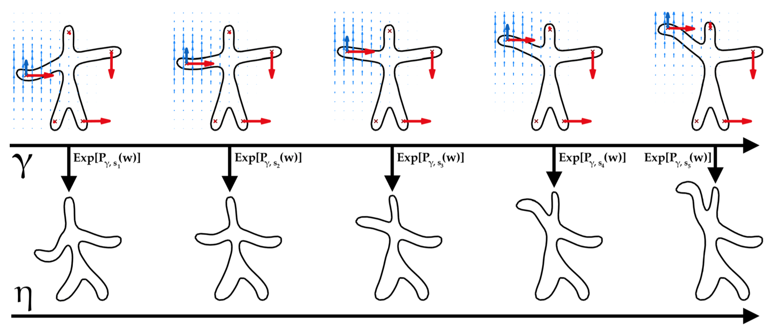
Exp-parallelism on our manifold of diffeomorphisms
Exp-parallelization transports a shape trajectory from one geometry to another
Learning distributions of shape trajectories from longitudinal datasets: a hierarchical model on a manifold of diffeomorphisms, Bône et al, 2017
Notes:
How does this generic concept applies on our specific manifold of diffeomorphisms ?
The source trajectory is the top row, and is parametrized by the blue arrows, which encode the lifting of the left arm
The space shift vectors are the red arrows, which are parallel-transported along the blue ones.
Taking the exponential of those transported red arrows, in other words deforming the top shapes according to the encoded diffeomorphisms, finalyy defines the shifted trajectory display at the bottom row.
We see that this operation is able to personalize the lifting of the left arm onto another subject with differing arm and legs configuration, in a way that respects its own geometry

Slide 20
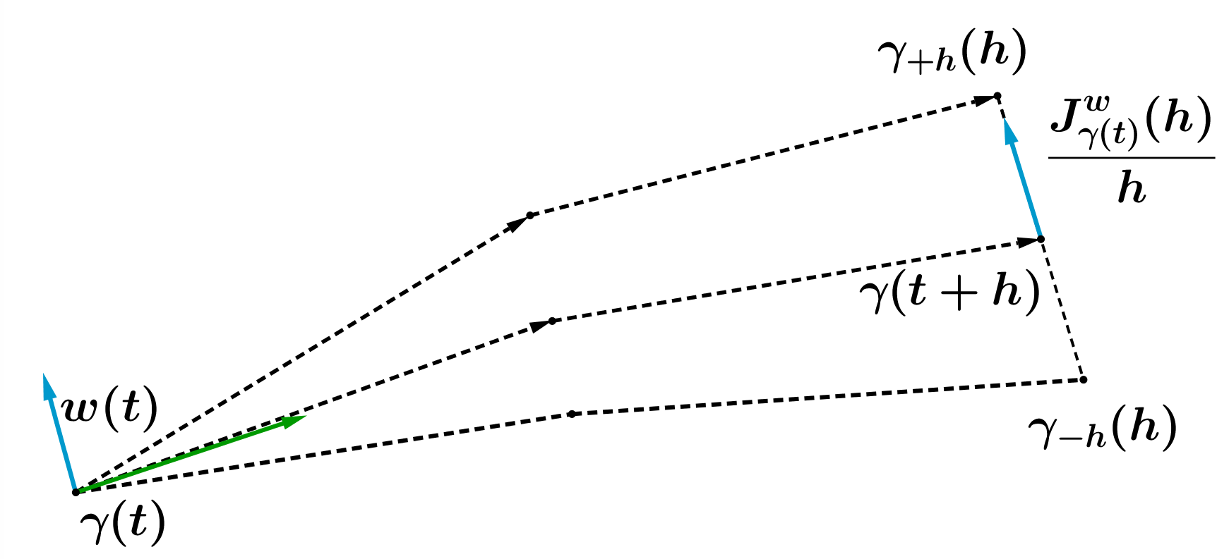
Computing parallel transport along a geodesic: the fanning scheme
2.
3.
1.
2.
1. Compute using a Runge-Kutta 2 on the Hamiltonian equations.
2. Compute and using a Runge-Kutta 2 on the Hamiltonian equations.
3. Compute the Jacobi field and renormalize the result.
Parallel transport in shape analysis: a scalable numerical scheme, Louis et al, 2017
Notes:
Just a parenthesis to mention that it was not obvious to devise a efficient numerical scheme for parallel transport.
We came up with this so-called fanning scheme that allows to efficient compute this operator along geodesics, relying only on Riemannian exponentials.

Slide 21
Learning the spatiotemporal variability in longitudinal data sets
Deformation model 10 mn
  A manifold of diffeomorphisms
  Exp-parallelism on manifolds
Statistical model 5 mn
  Graphical model
  Estimation
Experiments 15 mn
  Simulated man-shapes
  Hippocampal atrophy in ADNI

Slide 22




Mixed-effects statistical model
Notes:
We take a generative point of view to explain the construction of our statistical model, its parameters and random effects.
We first define control points, which define in turn a manifold of diffeomorphisms.
Choosing now a momenta and a time origin finally defines a time-indexed geodesic on this manifold.
This geodesic will represent the average main progression pattern of our population, for instance raising the left arm.
We will now define individual spatio-temporal transforms of this population geodesic, in order to fit the indivudal observations.
Starting with the temporal part, we define individual time-reparametrizing functions under the form of affine functions, where the pace and delay parameters are assumed normally distributed.
Continuing with the spatial part of the transformation, we draw space-shift parameter from a normal distribution, with a PCA-like method to reduce the dimension. Some special care is taken that this space-shift is orthogonal to the momenta m, for identifiability reasons.
We can finally shift the time-reparametrized geodesic onto the exp-parallel curve eta, which is expected to fit the observations.

Slide 23
Mixed-effects statistical model
Longitudinal deformations model
Notes:
- This graphical model can be interpreted as a Bayesian probabilistic model, containing both fixed-effects and random-effects.

Slide 24

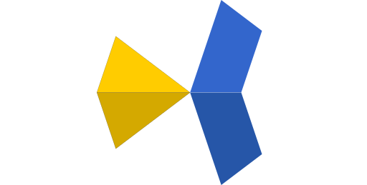
Estimation with the MCMC-SAEM
Longitudinal deformations model
Python code publicly available at:
www.deformetrica.org
KeOps: autodiff without memory overflows
www.kernel-operations.org
Initialization pipeline
Maximum likelihood
Mixed stochastic-deterministic core
Dedicated variation of the MCMC-SAEM algorithm
Adaptive MCMC-S step
Learning the spatiotemporal variability in longitudinal shape data sets, Bône et al., Submitted
Notes:
Because of this mixed-effect nature, the maximum likelihood of this model cannot be simply computed by gradient descent.
We devised a efficient variant of the SAEM algorithm, itself a variant of the EM algorithm. Many tricks are used to make this algorithm as efficient as possible, and the resulting estimation algorithm is publicly available in the Deformetrica software.
Initially C++ code, completely re-coded with Pytorch to benefit from the auto-differentiating librairy.
Parallel code, able to run on multiple CPU/GPUs
Critical convolution operations are coded with a specific memory-efficient CUDA library, compatible with autodiff

Slide 25
Learning the spatiotemporal variability in longitudinal data sets
Deformation model 10 mn
  A manifold of diffeomorphisms
  Exp-parallelism on manifolds
Statistical model 5 mn
  Graphical model
  Estimation
Experiments 15 mn
  Simulated man-shapes
  Hippocampal atrophy in ADNI

Slide 26
Simulated man-shapes
y_{1,1}
y_{1,2}
y_{1,3}
Individuals
y_{2,1}
y_{2,2}
y_{2,3}
Time
y_{3,1}
y_{3,2}
y_{3,3}
Time
Time

Slide 27
Simulated man-shapes: evaluation methodology

Slide 28
Simulated man-shapes: evaluation methodology

Slide 29
Simulated man-shapes: evaluation methodology

Slide 30
Simulated man-shapes: evaluation methodology

Slide 31
Simulated man-shapes: calibration performance

Slide 32
Simulated man-shapes: personalization performance

Slide 33
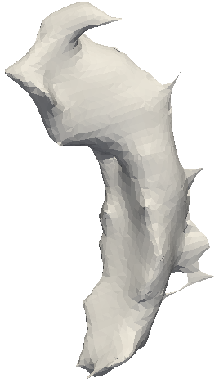





Hippocampal atrophy in Alzheimer’s disease
Individuals
Time

Slide 34

Hippocampal atrophy in Alzheimer’s disease

Slide 35







Estimated mean progression
63.8y
67.8y
71.8y
75.8y
79.8y
83.8y
87.8y

Slide 36















Estimated mean progression
63.8y
67.8y
71.8y
75.8y
79.8y
83.8y
87.8y

Slide 37
Estimated mean progression
Time

Slide 38







A component of geometric variability
+3σ
“Space”
+2σ
+σ
Time
-σ
-2σ
-3σ

Slide 39
A component of geometric variability

Slide 40














Spatiotemporal distribution of shape trajectories

Slide 41














Spatiotemporal distribution of shape trajectories

Slide 42














Spatiotemporal distribution of shape trajectories

Slide 43














Spatiotemporal distribution of shape trajectories

Slide 44














Spatiotemporal distribution of shape trajectories

Slide 45




























Spatiotemporal distribution of shape trajectories

Slide 46

http://www.digital-brain.org/ visualization

Slide 47

Population analysis: correlation with cofactors

Slide 48
Population analysis: correlation with cofactors

Slide 49
Population analysis: correlation with cofactors
Slightly stronger results with the left hippocampus
Strong sexual dimorphism
Notes:
- Marital status linked with social activity?
- Educated persons better compensate the anatomical decay of their brain; when detected and added to the study, the atrophy has started earlier than for less educated patients

Slide 50
Individual prediction of the anatomical changes
Notes:
Noise evaluated by comparing the considered measurement to the available « re-test » data, i.e. Secondary measurements performed on the same subject, same visit.
Natural baseline for prediction: assuming no change i.e. Keeping the measurements unchanged.
Reduced window between noise and constant prediction, that our method hits when predicting the evolution of the measurement in four years (here measurements are the shape of the hippocampus)

Slide 51
Conclusion
No restriction on the temporal sampling
Does not require point-to-point correspondence
Natural framework for prediction at the individual level
Generative modeling
Strengths
The calibration algorithm is computationally intensive
Dedicated to smooth and monotonic progressions (not adapted for cyclic movements e.g. the heart, reverting trajectories e.g. cancer tumours under treatment, abrubt phenomenons e.g. stroke or surgery)
Limits

Slide 52

Extension 1: Direct analysis of 3D T1-weighted MRIs
63y
67y
71y
75y
79y
83y
87y
Hierarchical modeling of Alzheimer's disease progression from a large longitudinal MRI data set, Bône et al, 2019
Notes:
- Ventricles size
- Confirmation of the correaltion results

Slide 53

Extension 2: other types of manifold-valued data
Model applicable to other types of manifold-valued data: potential for integrative modeling of disease progression
Potential for clinical dashboards to monitor the evolution of patients
Simulating Alzheimer’s disease progression with personalised digital brain models,, Koval et al, Submitted
Notes:
- Many applications are straightforwarly defined with this approach

Slide 54

Extension 3: mixture of separate or branching trajectories
Clustering of longitudinal shape data sets using mixture of separate or branching trajectories,, Debavelaere et al, 2019

Slide 55
Thank you for your attention!
Thank you
Thank you
Individuals
Thank you
Thank you
Thank you
Thank you
Thank you
Thank you
Thank you
Time

